Slide 1
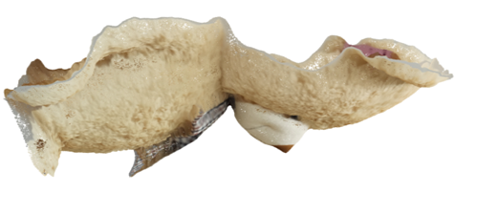
N(z₄) = 4
N(z₃) = 6 N(z₂) = 6
N(z₁) = 4
Hologram plane

Slide 2

N(z₄) = 4
N(z₃) = 6 N(z₂) = 6
N(z₁) = 2
N(z_{2,}z₃) = 1
N(z₄) = 3
N(z₅) = 1
N(z_{6,}z₇) = 3
Hologram plane

Slide 3

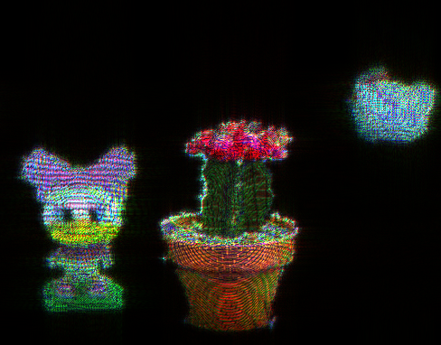
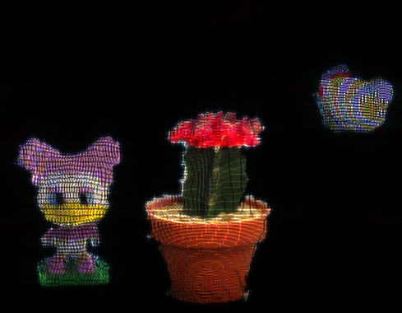
N(z₁) = 2
N(z_{2,}z₃) = 1
N(z₄) = 3
N(z₅) = 1
N(z_{6,}z₇) = 3
Hologram plane
(a)
(b)
(c)
(d)

Slide 4
